Slide 1


Slide 2
Introduction
We can call existing Oracle Reports and Charts from an Oracle Form by using the RUN_PRODUCT Procedure
  This procedure can be called when a Menu Item or Button is clicked

Slide 3
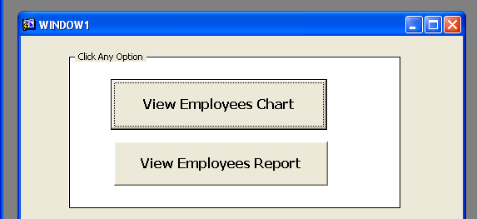
Sample Form

Slide 4
Generating a Report
BEGIN
RUN_PRODUCT(REPORTS, 'z:\form_rep.rdf', ASYNCHRONOUS,
RUNTIME, FILESYSTEM, ‘’, NULL);
END;
This built-in procedure requires you to specify seven arguments.
The first argument is the name of the product to be executed. Example: GRAPHICS, REPORT, etc.
The second argument is the name of the module containing the product. This must include both the directory and the name of the product.

Slide 5
Syntax Explanation
The third argument is the communication mode, which can be either SYNCHRONOUS or ASYNCHRONOUS. The Synchronous communication mode indicates that the product being run must be exited before control can return to the form that called the product. With Asynchronous communication the user can return to the form while the other product is still being run
The fourth argument is the execution mode, which can be either BATCH or RUNTIME. The RUNTIME option specifies that the module is to be executed in the product’s run-time environment. The BATCH option requires that the product first generate an executable version of the module.

Slide 6
Syntax Explanation
The fifth argument is the location of the module, which can be either FILESYSTEM or DB. FILESYSTEM, which indicates that the module is stored in a file in the local operating system. DB indicates that the module is stored in the Oracle database on the server.
The sixth argument is the name of the parameter_list to be passed to the module when it is started in the specified product.
The final argument ‘DISPLAY’ is used when the Graphics product is run in the BATCH execution mode. In RUNTIME mode, mention NULL

Slide 7
Generating a Chart
BEGIN
RUN_PRODUCT(GRAPHICS, 'z:\SQL\CHART1.OGD',
ASYNCHRONOUS, RUNTIME, FILESYSTEM, ‘’, NULL);
END;

Slide 8
Worksheet
Create a form which contains a button. When button is clicked, it should display a report.
Create a menu having two main options Reports and Charts. Each should have sub-options to call different types of reports and charts seperately. The number of suboptions depend on the number of reports/charts you have. Then design a which contains this menu. The form should also have an image in its canvas.

